Slide 1
.Net TraiNING

Slide 2
AGENDA
Functions
declaration and defination
Object Oriented Programming
Class , Object, Constructor
Encapsulation
Abstractions
Inheritance
Polymorphism

Slide 3
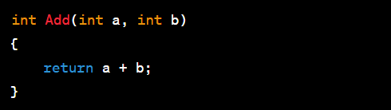
Functions and Debugging
A method is a code block that contains a series of statements and performs a specific task
Method Declaration
void function
Return Type
Parameters
return statement

Slide 4
Object Oriented Programming
object-oriented programming is about creating objects that contain both data and methods.
class
object
Access modifier
Encapsulation
Abstraction
Inheritance
Polymorphism

Slide 5
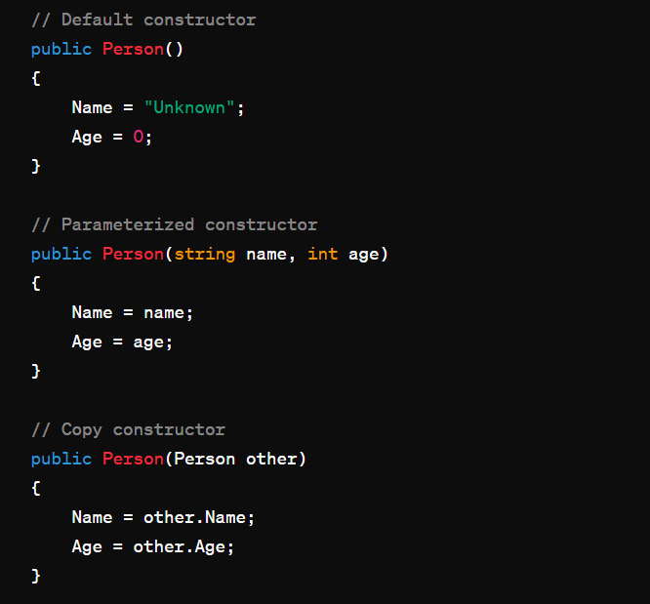
Constructor
A constructor is a special method that is used to initialize objects.
The advantage of a constructor, is that it is called when an object of a class is created.
It can be used to set initial values for fields
types :
Default Constructor
Parameterized Constructor
Copy Constructor

Slide 6
Access Modifiers
Public (public ):
Members declared as public are accessible from any other code in the same assembly or another assembly that references it.
Private (private):
Members declared as private are only accessible within the same class or struct.
Protected (protected):
Members declared as protected are accessible within the same class or struct and by derived classes.
Internal (internal):
Members declared as internal are accessible within the same assembly but not from another assembly.

Slide 7
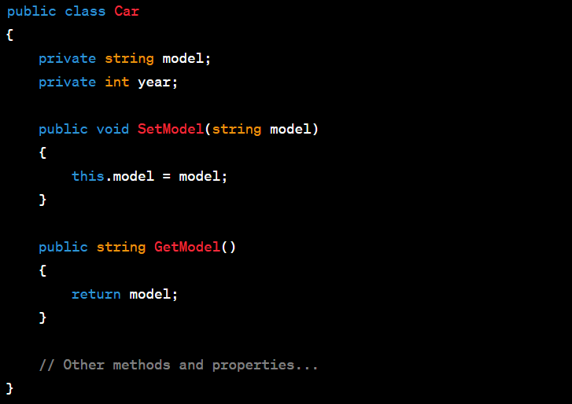
Encapsulation
Encapsulation is the concept of bundling data (attributes) and methods (functions) that operate on the data into a single unit known as a class.

Slide 8
Assignment 1 - Project
mini-project that involves CRUD (Create, Read, Update, Delete) operations using a list, for and foreach loops, if-else statements, and a switch case in C#. In this project, we'll create a basic task list application.
Project Description: Simple Task List Application
Features:
Create a task: Add a new task with a title
Read tasks: Display the list of tasks with their titles and descriptions.
Update a task: Modify the title or description of an existing task.
Delete a task: Remove a task from the list.
Exit: Exit the application.

Slide 9
Thank You

